Slide 1
Presentations – practical advice
Michał Bujacz
Instytut Elektroniki
Politechnika Łódzka

Slide 2
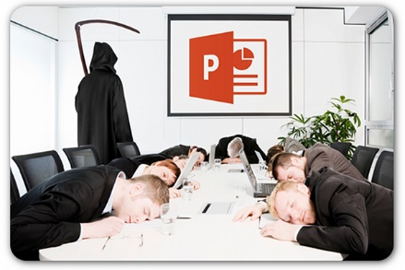
Clear goal
https://www.cloud-business-school.com/conseil/design-presentations/
E.g.:
Save people from „death by powerpoint”
Teach students something useful
Inform about research findings

Slide 3

Hard opening!
Joke
Question/Interaction
"Fun fact"
More people killed by vending machines than sharks!
95% probability of a common ancestor 15-20 generations ago

Slide 4

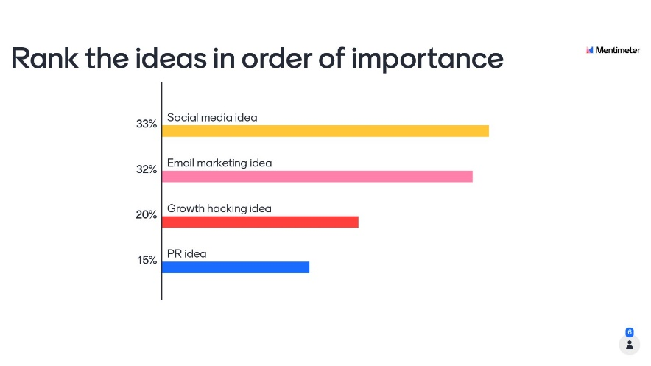
Interaction
Ask the audience a question
Give a task to perform
Survey or test
mentimeter.com

Slide 5

Body language
Eye contact
Openness
Smile
Mirroring
https://www.genardmethod.com/blog/how-to-read-body-language-5-ways-your-audience-can-make-you-a-better-speaker

Slide 6
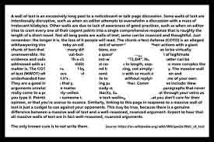

No „Text walls” !
Max five phrases/bullet points
Avoid verbs/senteces
Graphics emphasizing your message
Yes!
Yes!
Yes!
NO

Slide 7
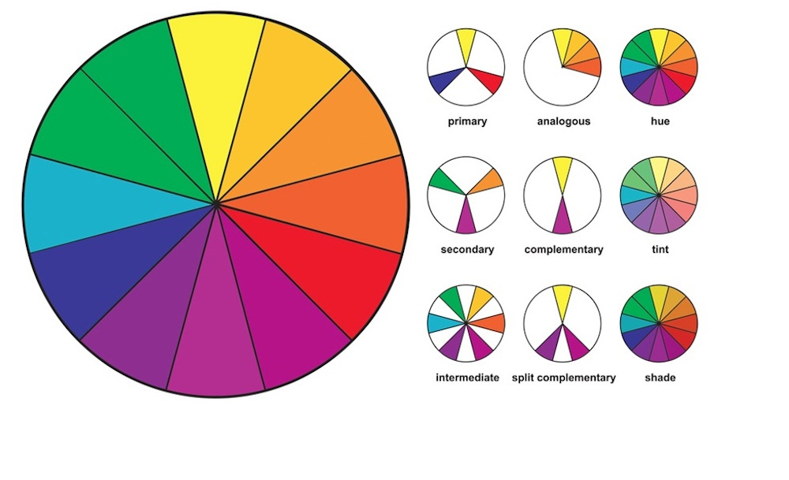
Consistent design
One font (2-3 sizes), clearly readable
Same template for all slides
Only the necessary animations
Aesthetic pallete (coolors.com)
Contrast (webaim.org)
https://creativemarket.com/blog/10-basic-elements-of-design

Slide 8

How many slides?
Rule of thumb: 1 slide = 1 minute
„Pecha kucha” 20 slides, 1 slide = 20s and (format popular for arts/design, but not good for technical persentations)
„TED talk” – no slides or just technical figures
Video no more than 20% of presentation time

Slide 9

Technical details:
Authors and affiliations on first and last slide
Slide numbers!
Links to sources

Slide 10


Safety
Backup format (PPT + PDF)
Backup data source (e.g. pendrive + online)
Check the projector and video before presenting

Slide 11

Practice, practice, practice
Not everyone can improvise
Script, but no reading!
At least 3 trial runs
Record yourself – be your own test audience

Slide 12
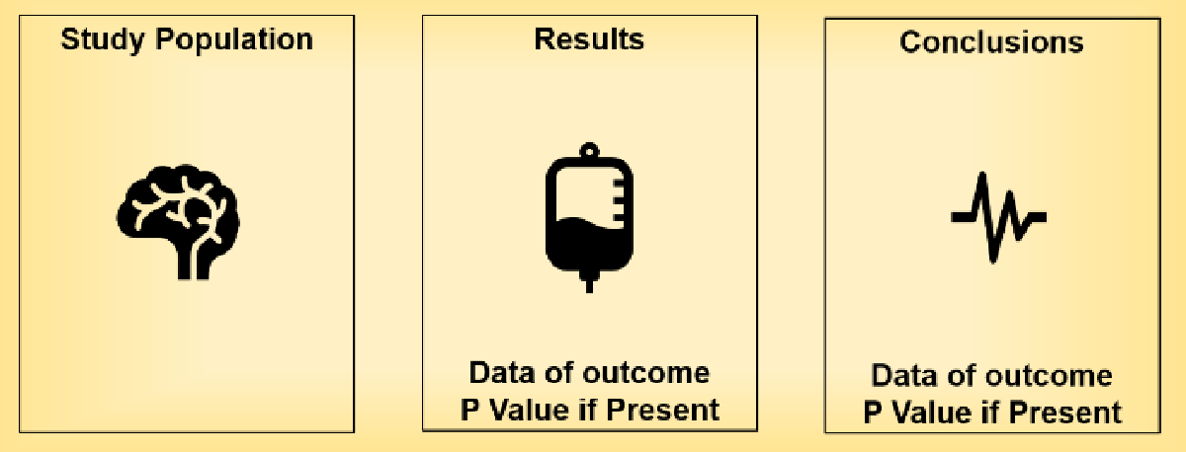
Final slide
Thank you
Questions?
Visual abstract
Names/affiliations
Links

Slide 13




Thank you! Questions?
Practice
Tech check
This presentation can be found at:
www.eletel.p.lodz.pl/bujacz
Dr inż. Michał Bujacz Institute of Electronics

Slide 14

Graphical materials
HOMEWORK EXERCISE
ORAL EXERCISE
BOARD EXERCISE
PROGRAMMING EXERCISE

